Slide 1
GLOBAL MENTAL HEALTH CRISIS 2016
SUCIDE RATES, FACILITIES, HUMAN RESOURCES DATA ANALYSIS PRESETATION
BY
AYODELE JOSEPH OLUWATIMILEHIN

Slide 2
EXECUTIVE SUMMARY
This comprehensive analysis examines global suicide rates, mental health infrastructure, and human resources across 183 countries using WHO data from 2016. The dashboard reveals critical disparities in suicide rates between nations and highlights the correlation between mental health resource availability and population vulnerability.
Key Metrics Countries Analyzed: 183 Average Global Suicide Rate: 11.5 per 100,000 HighestRate: 30.2 per 100,000 (Guyana) Lowest Rate: 1.6 per 100,000 (Bahrain)

Slide 3
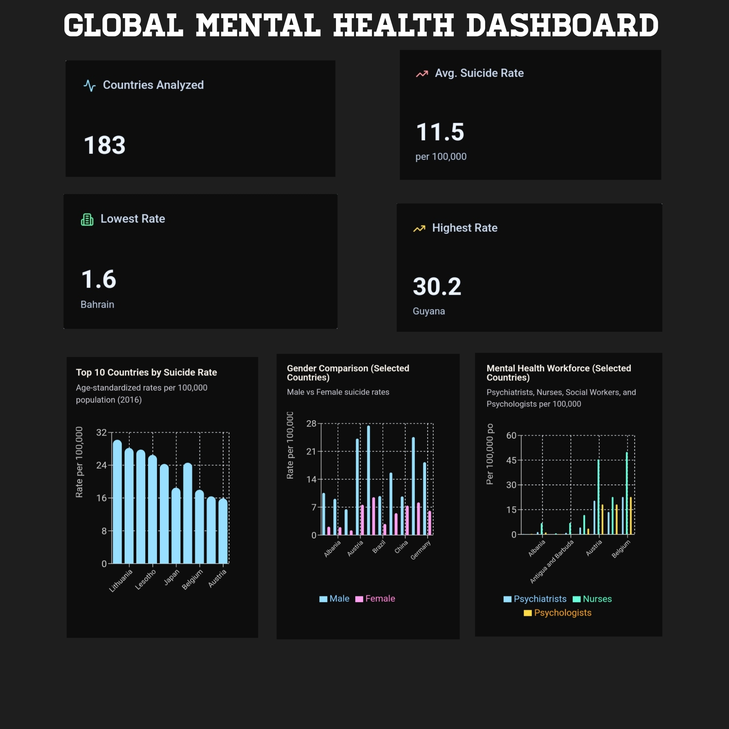

Slide 4
KEY FINDINGS
1. Age Group Vulnerability
Suicide rates vary dramatically across age groups, with elderly populations showing significantly higher vulnerability:
10-19 years: 3.5 per 100,000
20-29 years: 10.2 per 100,000 (peak for younger adults)
40-49 years: 6.6 per 100,000
70-79 years: 11.0 per 100,000
80+ years: 42.0 per 100,000 (highest risk group)
The dramatic increase in the 80+ age group indicates that elderly populations require specialized mental health interventions and support systems.

Slide 5
KEY FINDINGS
2. Gender Disparities
Males consistently show higher suicide rates than females across all analyzed countries:
Male-to-Female Ratio: Typically 2:1 to 4:1
Example - Austria: Males 24.2 vs Females 7.6 per 100,000
Example - Belgium: Males 27.5 vs Females 9.5 per 100,000
Example - China: Males 9.7 vs Females 7.4 per 100,000 (smallest gap)
This consistent pattern suggests gender-specific risk factors and potential differences in help-seeking behavior.

Slide 6
KEY FINDINGS
3. Mental Health Workforce Distribution
Developed nations have significantly higher mental health professional density:
High-Resource Countries (per 100,000):
Austria: 20.5 psychiatrists, 45.5 nurses
Belgium: 22.7 psychiatrists, 50.0 nurses
Canada: 15.9 psychiatrists, 31.8 nurses
Low-Resource Countries (per 100,000):
Afghanistan: 0.23 psychiatrists, 0.10 nurses
Angola: 0.06 psychiatrists, 0.66 nurses
Albania: 1.47 psychiatrists, 6.88 nurses

Slide 7
KEY FINDINGS
4. Mental Health Facilities Gap
Access to mental health facilities varies dramatically:
Developed Nations: Multiple facility types including mental hospitals, outpatient clinics, day treatment, and residential facilities
Developing Nations: Often limited to basic health units or outpatient facilities
Resource Constraint: Many countries lack specialized residential or day treatment facilities

Slide 8
REGIONAL INSIGHTS
Eastern Europe & Central Asia
Highest suicide rates globally (Lithuania 28.2, Hungary 24.3)
Moderate mental health workforce availability
Potential factors: Economic transition, social disruption, alcohol use
East Asia
South Korea (24.6) and Japan (18.5) show elevated rates despite developed economy status
Possible factors: Work-related stress, social pressures, cultural attitudes toward mental health
Relatively strong mental health infrastructure
Sub-Saharan Africa
Lesotho (26.5) shows high rates despite limited resources
Severe shortage of mental health professionals
Limited facility infrastructure
Western Europe
Belgium (18.0), France (16.4), Austria (15.9) show elevated rates
Strongest mental health infrastructure and workforce
Possible factors: Aging population, social isolation

Slide 9
RESOURCE-OUTCOME CORRELATION
Observation
Countries with higher mental health resource availability do not necessarily have lower suicide rates. This suggests:
1. Resource Distribution: Availability doesn’t guarantee accessibility or quality of care
2. Cultural Factors: Stigma, help-seeking behavior, and cultural attitudes significantly influence outcomes
3. Socioeconomic Factors: Economic development, employment, and social cohesion play crucial roles
4. Demographic Factors: Age structure and gender composition affect population level rates

Slide 10
RECOMMENDATIONS
Immediate Actions
1. Targeted Interventions: Focus on high-risk age groups (20-29 and 80+)
2. Gender-Specific Programs: Develop male-focused mental health awareness and intervention programs
3. Workforce Development: Increase mental health professional training in low resource countries
Long-term Strategies
1. Infrastructure Investment: Build mental health facilities in underserved regions
2. Community-Based Care: Develop accessible, culturally appropriate mental health services
3. Prevention Programs: Implement suicide prevention initiatives targeting vulnerable populations
4. Data Collection: Improve data quality and completeness for better monitoring

Slide 11
CONCLUSION
The global mental health crisis requires a multifaceted approach addressing both resource availability and cultural factors. While developed nations have stronger infrastructure, suicide rates remain elevated, indicating that access to services alone is insufficient. Comprehensive strategies must address socioeconomic factors, cultural attitudes, and targeted interventions for high-risk populations.
The data underscores the urgent need for:
Equitable distribution of mental health resources
Culturally tailored interventions
Special focus on elderly and young adult populations
Gender-specific mental health programs
Integration of mental health into primary care systems

